Slide 1


Slide 2
ET - Pizzeria
By: Zuza, Emily, Sam, Garrett, Noah, and Leo.

Slide 3

The Story of ET-Pizzeria
The ET-Pizzeria, your Aunt ET's fabulous pizza place, on your home planet Jupiter. One morning you wake up to a note from Aunt ET. She is going to visit Pluto and is leaving the pizzeria in your capable hands.
TL2: Emily Thomas

Slide 4

The Story of ET-Pizzeria
You excitedly get to the pizzeria to open, but you are the only one there. You must manage the pizzeria by taking orders, placing toppings, baking, cutting, and facing the customer's judgement. You must keep the customers happy to keep your Aunt's pizzeria open!
TL2: Emily Thomas

Slide 5
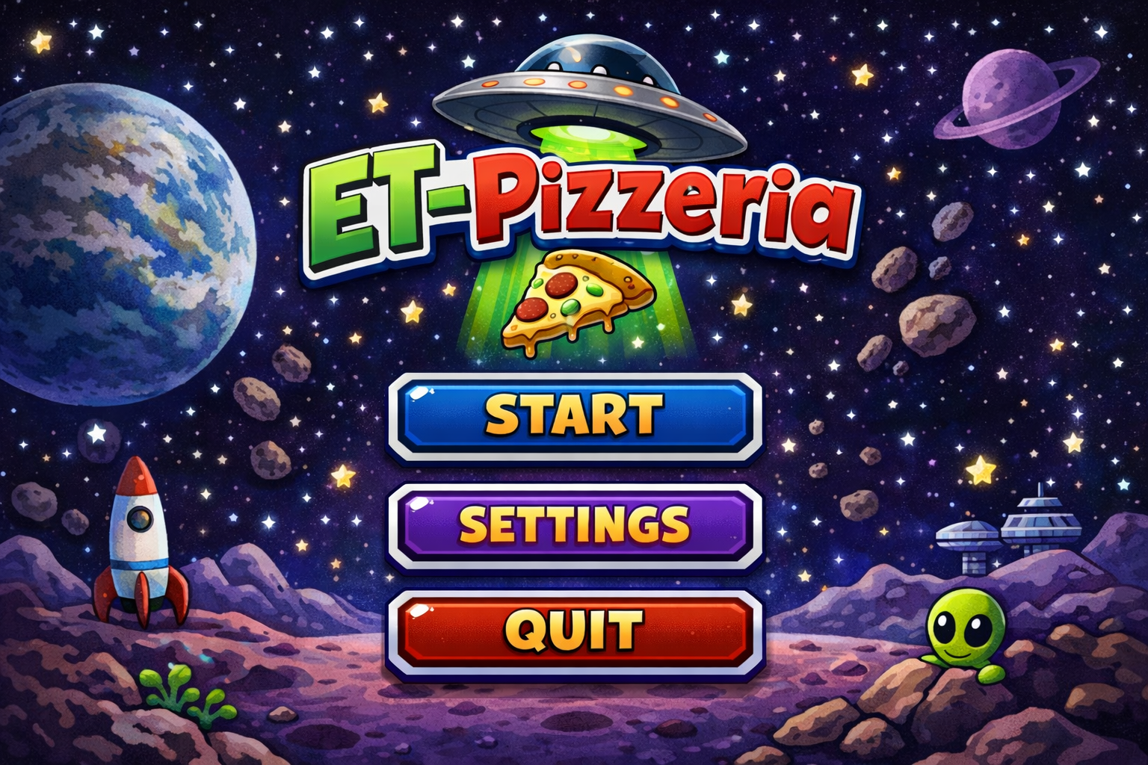
Scene 1: Load-up to Main Menu
Dialogue:
Order Taking and order specifications from the customer
Action:
None
Notes:
Graphically display the order, calm music in the background, and restaurant sounds
Dialogue
None
Action
Selection of starting main gameplay, adjusting settings, or quitting the game
Notes
Subtle background music
No sounds or effects
Simple 2D menu
a​​​
TL5: Garrett Brown

Slide 6
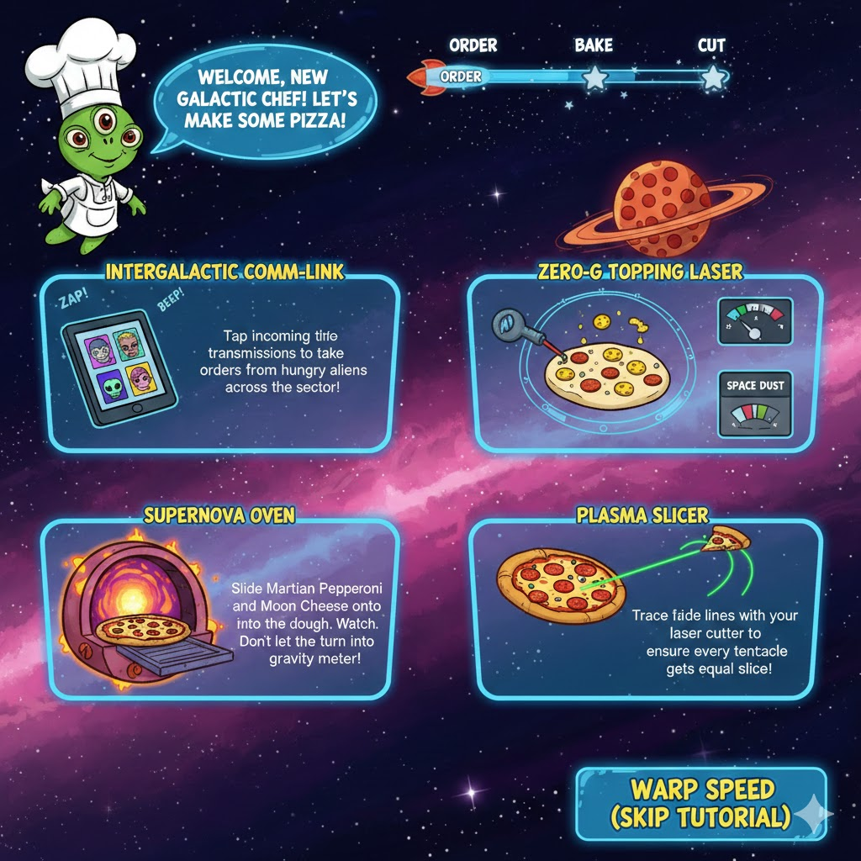
Scene 2: Load-up to Tutorial
Dialogue
Explained controls and story
Action
Skip tutorial
Notes
None
​​​
TL2+ - Sam

Slide 7
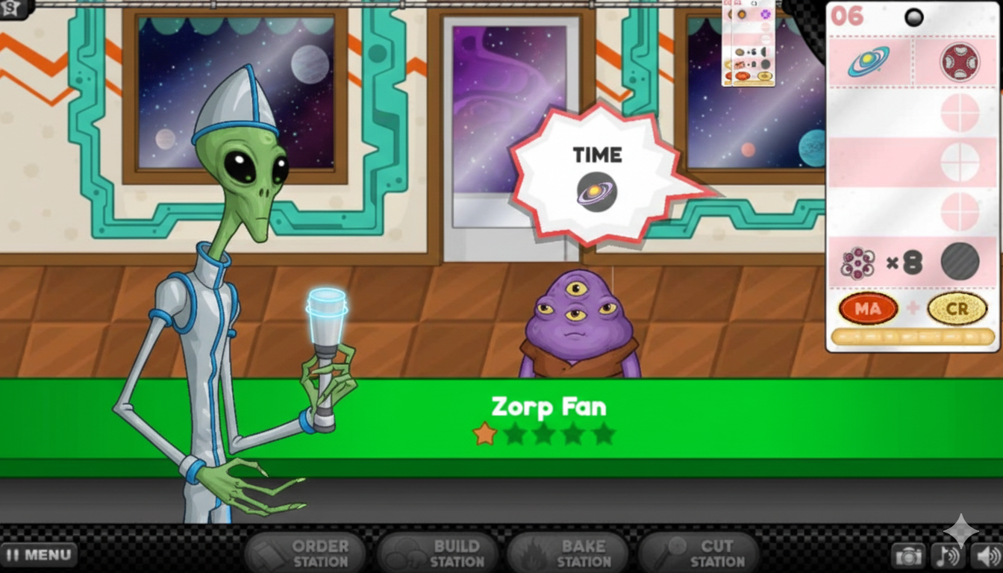
Scene 3: Order Station
Dialogue:
Order Taking and order specifications from the customer
Action:
None
Notes:
Graphically display the order, calm music in the background, and restaurant sounds
TL1: Zuzanna Whitman

Slide 8
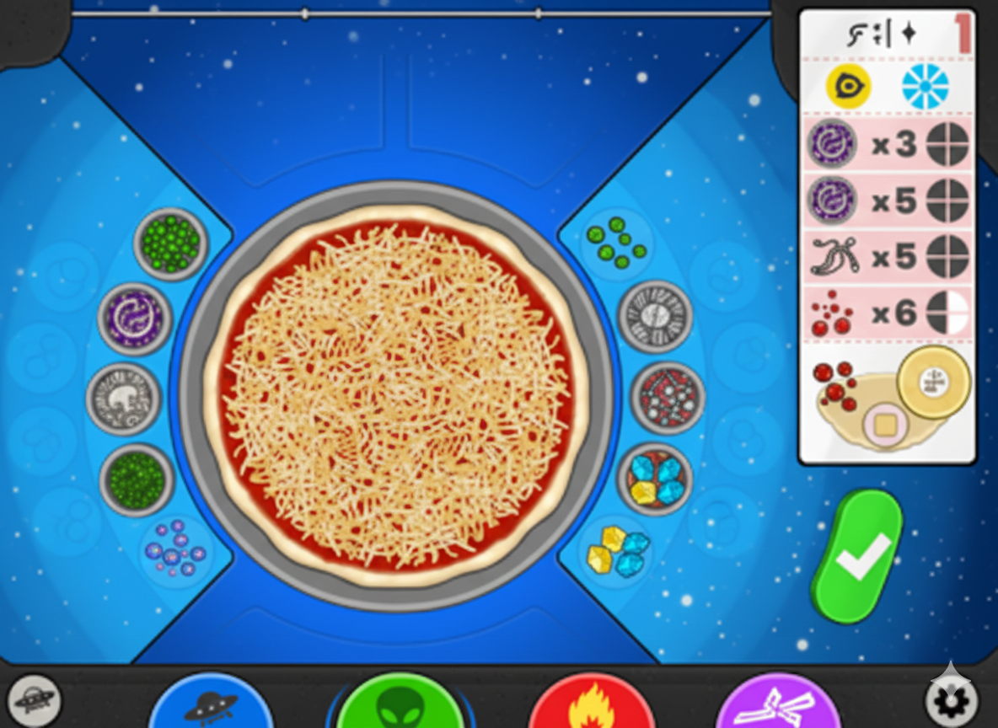
Scene 4: Topping Station
Dialogue:
Order Taking and order specifications from the customer
Action:
None
Notes:
Graphically display the order, calm music in the background, and restaurant sounds
Dialogue:
None
Action:
Pick Toppings
Place Toppings
Submit Pizza for Baking
Notes:
Graphically display the order ticket, all available toppings, and placed toppings
TL2: Emily Thomas

Slide 9
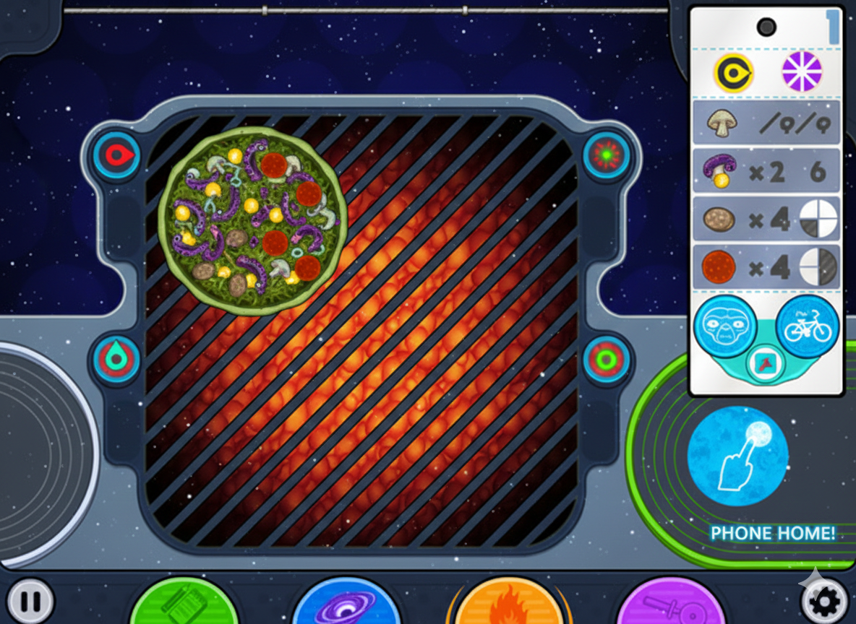
Scene 5: Baking Station
Dialogue
None
Actions
Place Pizzas on Oven
Keep Track of Bake TImers
Remove Pizza at Correct Time
Notes
Graphically display bake timers
Bake timers will display different colors to show undercooked, perfect, and burned
Cooking noises will be played

Slide 10
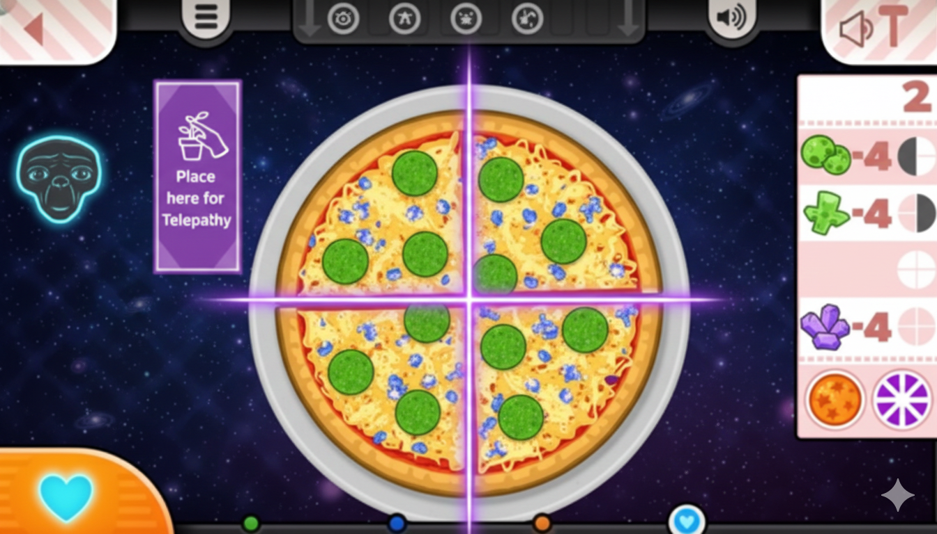
Scene 6: Cutting Station
Dialogue:
none
Action:
Cut the pizza
Trash the pizza
Move the pizza forwards
Notes:
Graphically display the pizza,
TL2+ – Sam

Slide 11
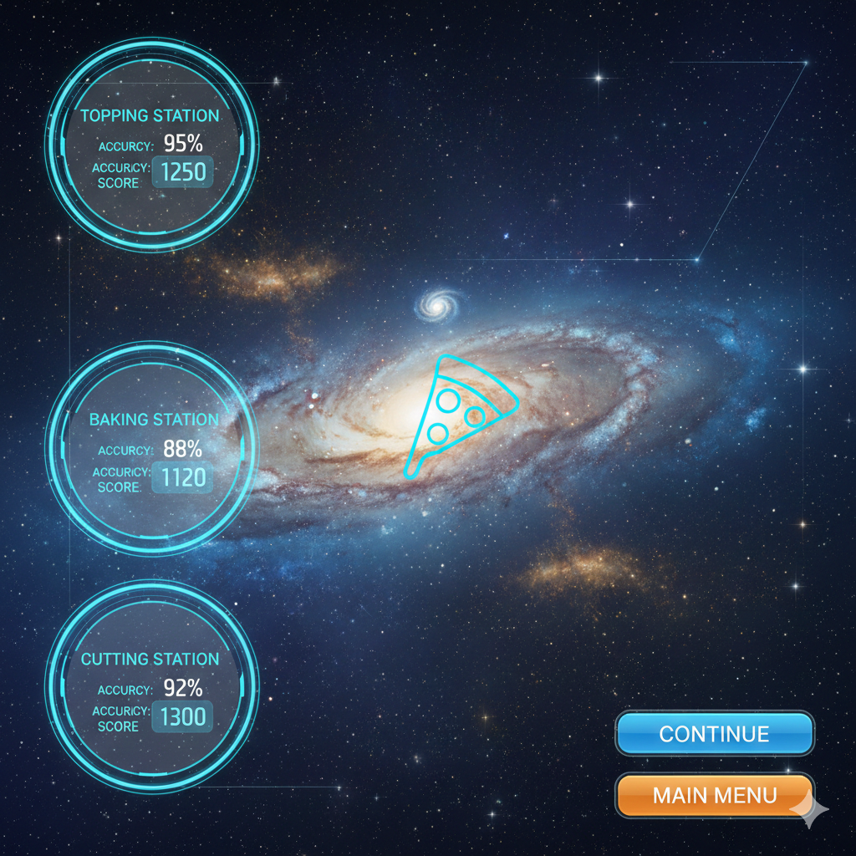
Scene 7: End Day Screen
Dialogue:
Topping Station
Baking Station
Cutting Station
Action:
Continue
Main Menu
Notes:
Graphics that show each area
TL4 - Noah

Slide 12
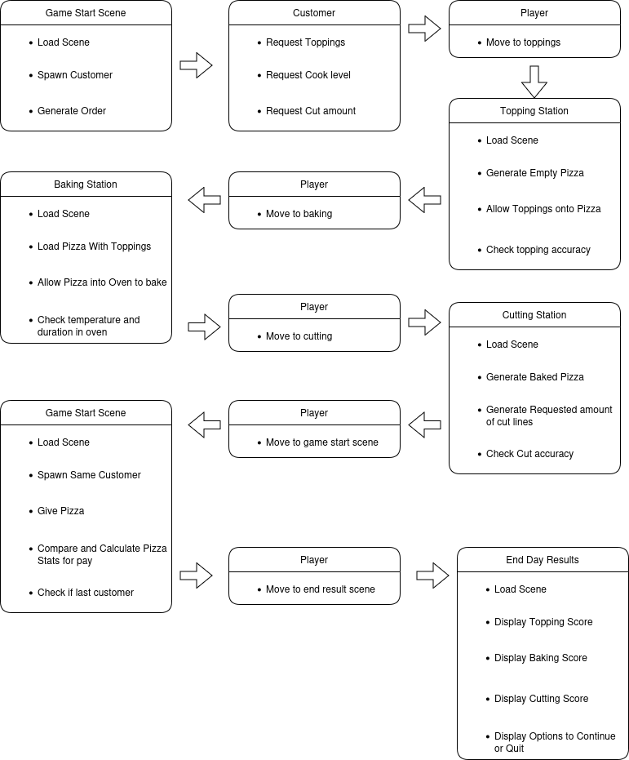
Global Use Case
TL4 - Noah

Slide 13
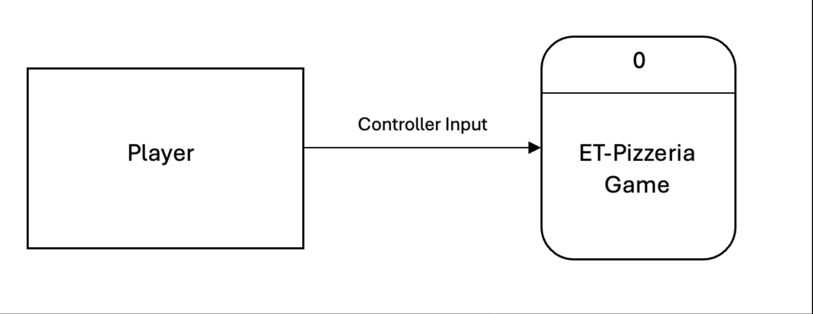
Context Diagram
TL2+ - Sam

Slide 14
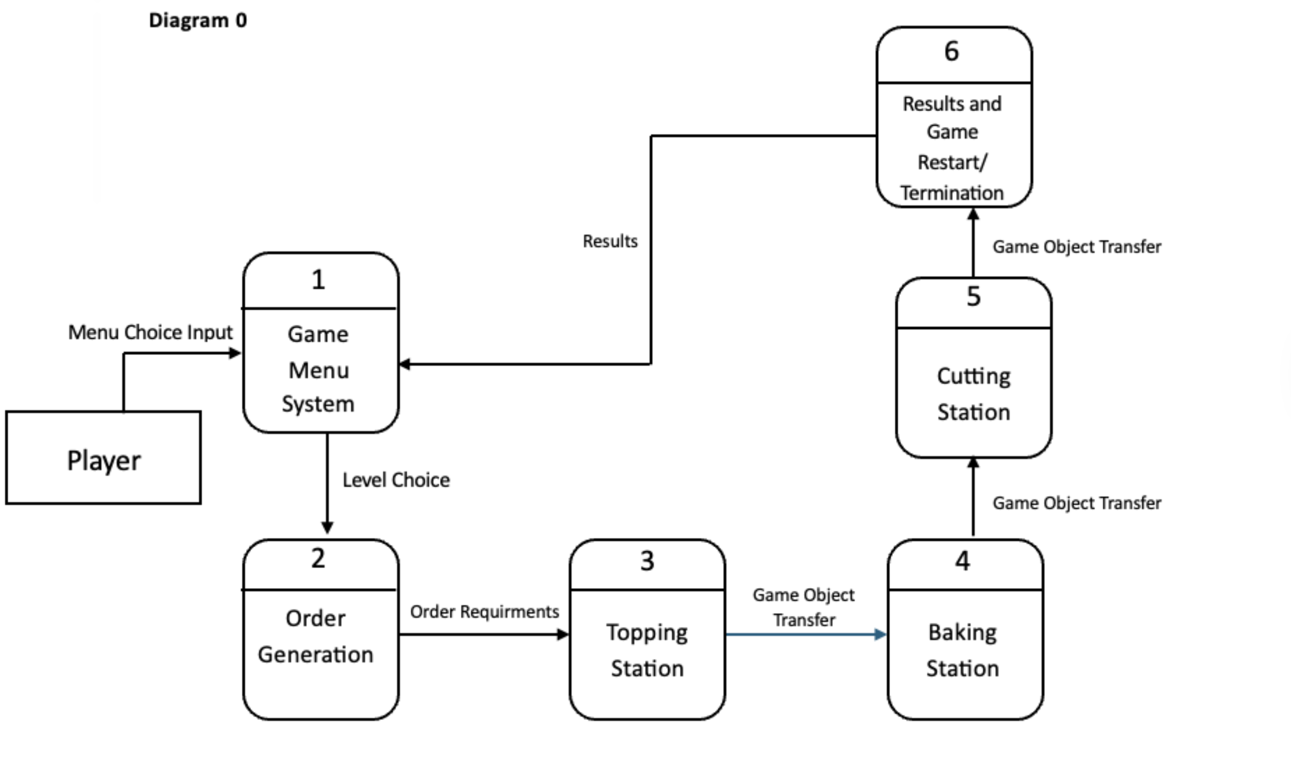
Level 0 Diagram
TL2+ - Sam

Slide 15
Individual Use case

Slide 16
TL5: Garrett - Menus
Start Game
Adjust Settings
Pause Game
Quit Game

Slide 17

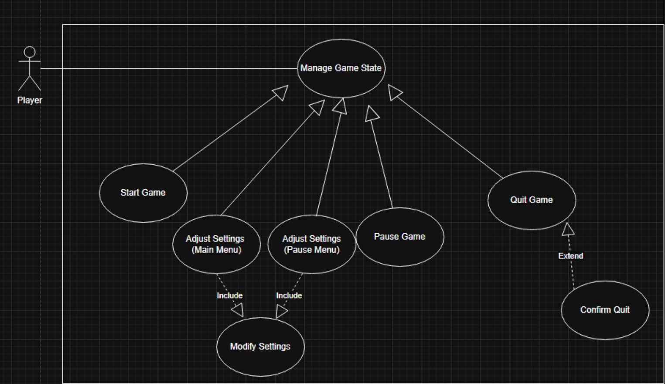
TL5: Garrett -Use Case Priority: High Complexity: Low

Slide 18
Zuzanna – Order Station
Generating orders
Displaying the order animation
Processing the order data
TL1: Zuzanna Whitman

Slide 19
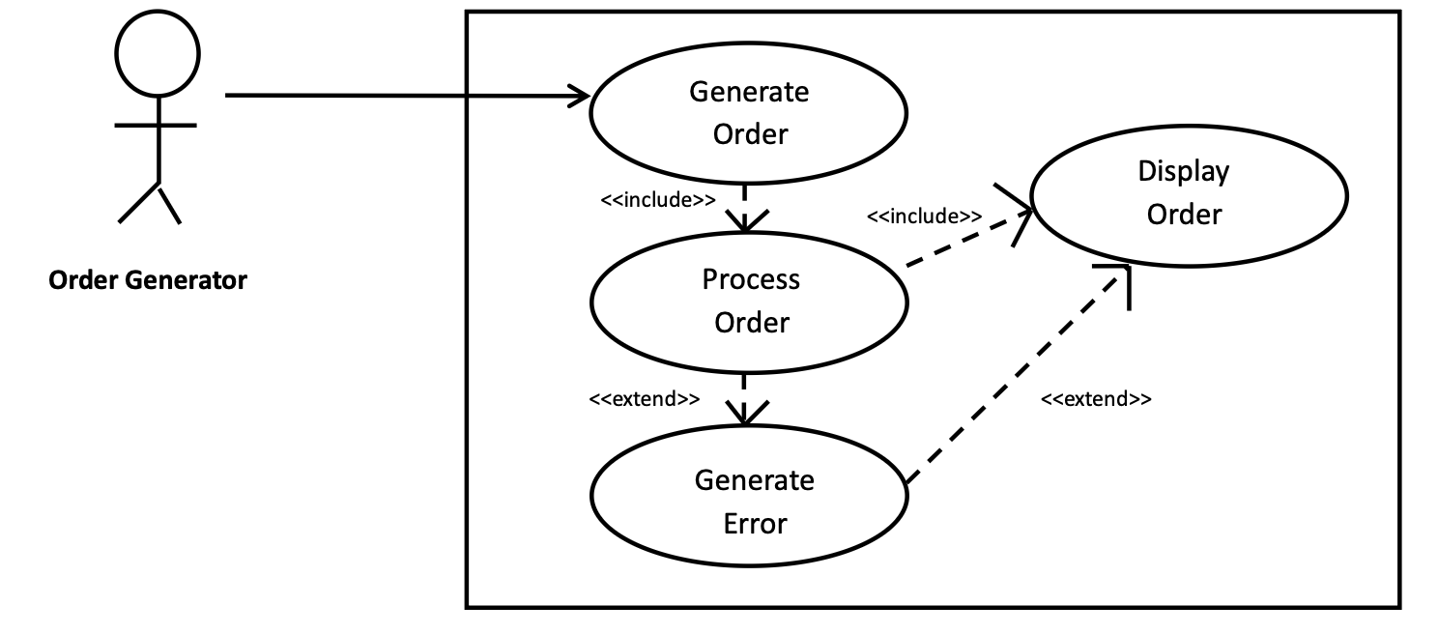
Zuzanna Use Case
TL1: Zuzanna Whitman

Slide 20
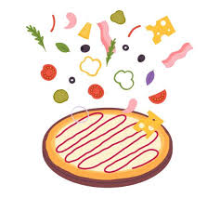
Emily – Topping Station
Prepare Pizza at Topping Station
Select Topping
Place Topping
Remove/Undo Topping
Submit Pizza
Receive Score
TL2: Emily Thomas

Slide 21
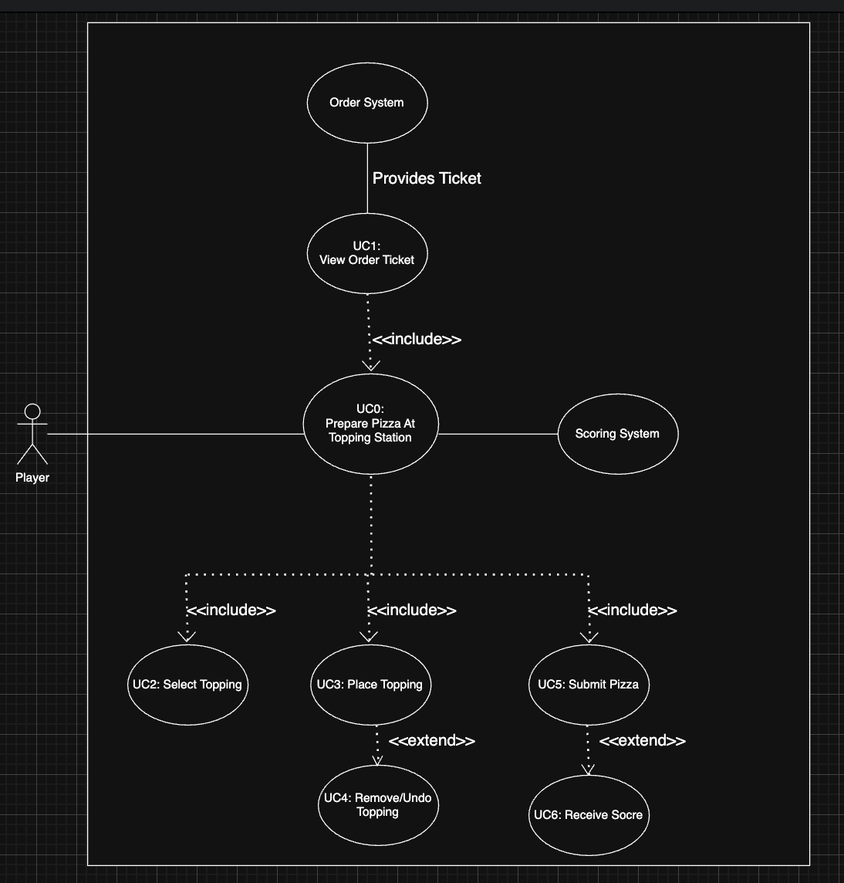
Emily Use Case
TL2: Emily Thomas

Slide 22
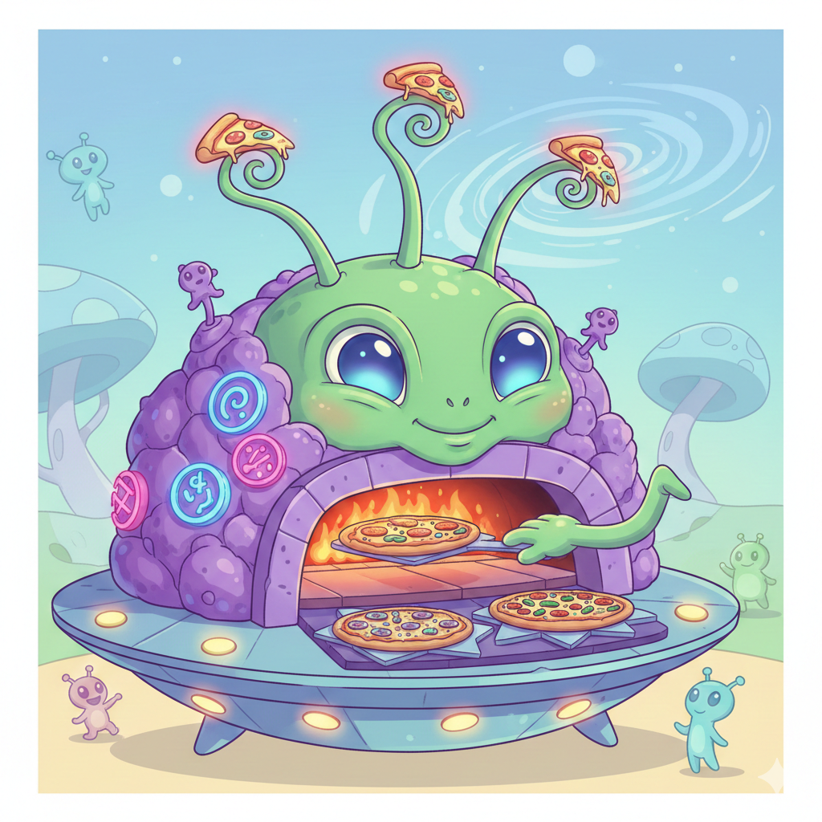
Leo - Baking Station
Place Pizza on Oven
Observe Bake Timers
Remove Pizza at Correct Time

Slide 23
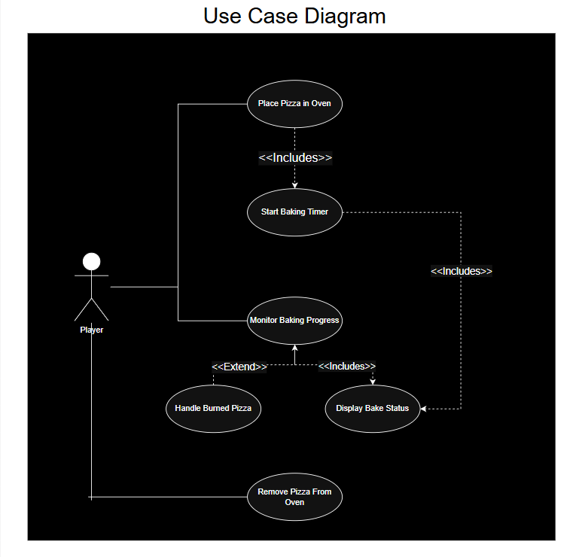
Leo Use Case

Slide 24
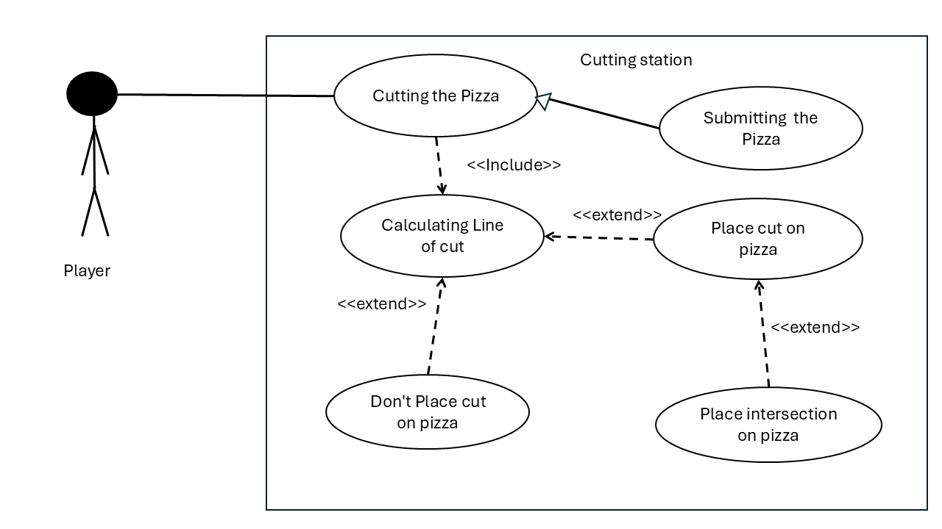
Sam – Cutting Station
Purpose:
The ability for the player to cut pizza to server their customers.
Priority: High
One of the main actions of the game
Complexity: Medium
TL2+ – Sam

Slide 25
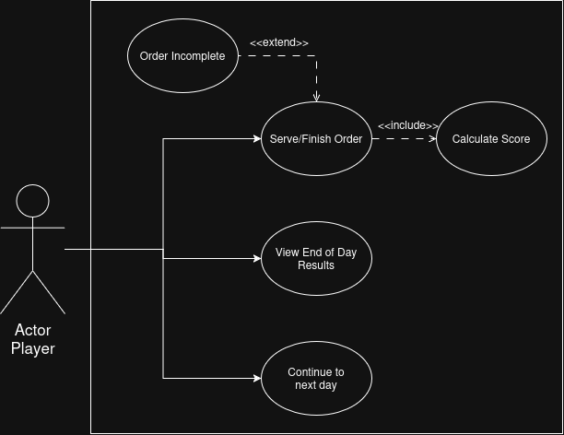
Noah Use Case
TL4-Noah

Slide 26
End

